Slide 1

BUSINESS PROBLEM:
- To find out the claims done by hospital to insurance company are genuine or fraudulent.
BUSINESS OBJECTIVE:
- The objective of the analysis is to predict an item when sold, what is the probability that customer would file fraudulent / Genuine warranty and to understand important factors associated with them.

Slide 2
Overview of Data
In the given Insurance data set there are 34 variables having 1048575 observation. The variables name are as follow,
Area- service 13.Home&self care 25. payment- topology-1
Hospital Certificate 14. Year discharge 26.payment- topology-2
Certificate_Num 15. ccs_diagnose_code 27. Payment – topology-3
Hospital ID 16.ccs_diagnosis_description 28. weight-baby
Hospital Name 17.ccs_procedure code 29.Abortion
Age 18. ccs_procedure _description 30. Emergency dept-yes/No
Zip_Code_3_digits 19. apr_drg_ description 31.Total-charge
Gender 20.apr-mde-discription 32.Total-cost
Cultural Group 21.code- illness 33.ratio_of_total_costs_to_total_charges
Ethinicity 22.Description – illness 34.Result
Days_Sept_Hospital 23.Mortality Risks
Admission Type 24.Surg- Description

Slide 3
Exploratory Data Analysis (EDA) and
Feature Engineering

Slide 4
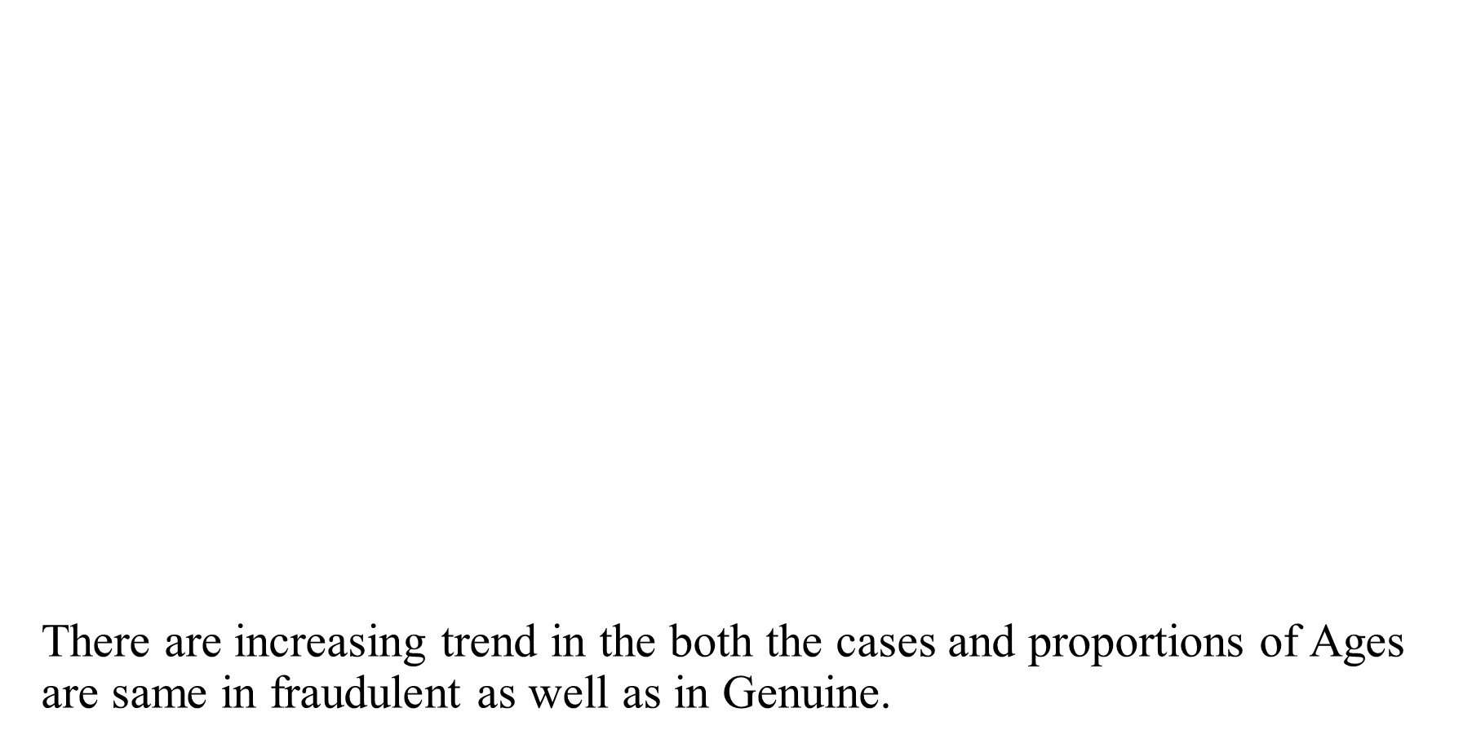
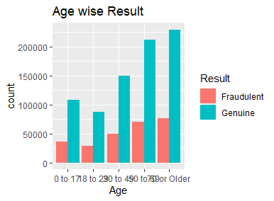
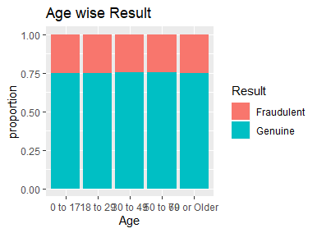
Age

Slide 5
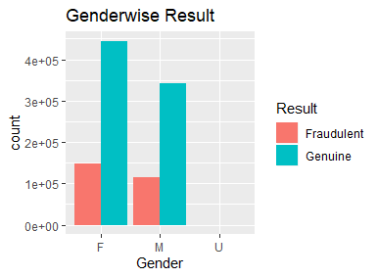
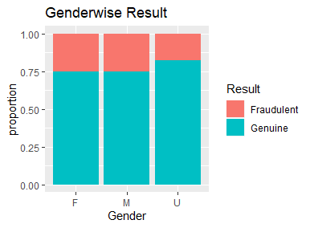
Gender
The proportion of female and male are same in fraudulent as well as in Genuine case.

Slide 6

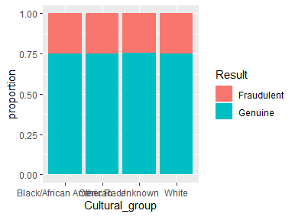
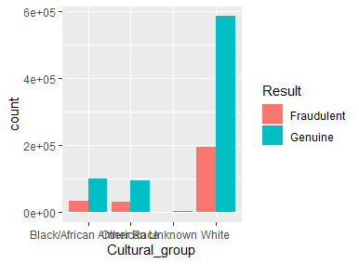
When it comes to cultural group whites are joined in hospitals in huge number
As well as proportional of cultural group are same in fraudulent and genuine which mean that our data is balance

Slide 7
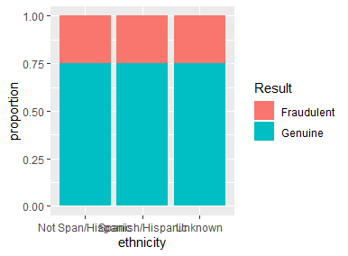
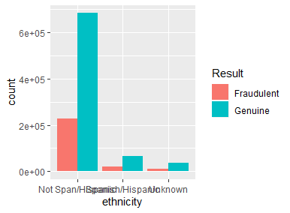
In followings graph of Ethnicity, the Not Span/Hispanic are is more fraudulent and genuine than the Spanish and unknown
The proportion of Ethnicity are same in Fraudulent and Genuine

Slide 8
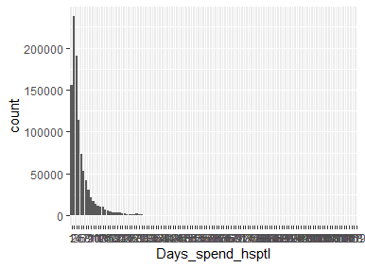
Days spend in hospital
There are 2373303 patients spend the two days(Maximum) in hospital
Whereas 52919 patients spend six days(Minimum) in the hospital

Slide 9
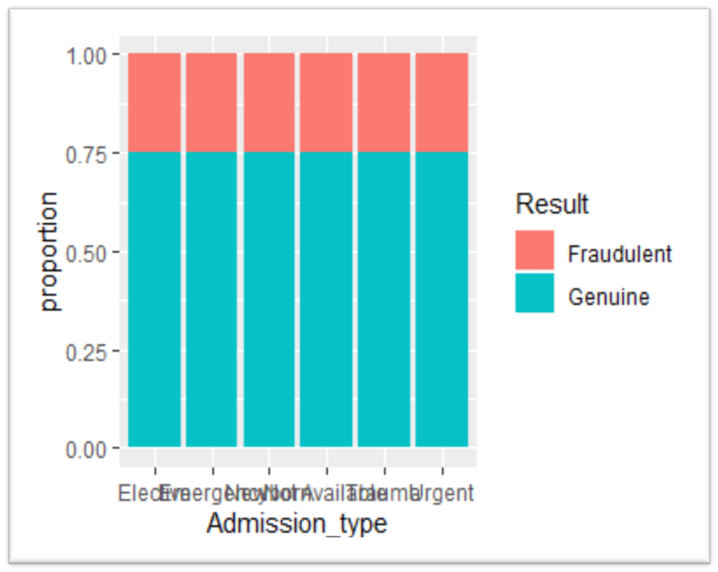
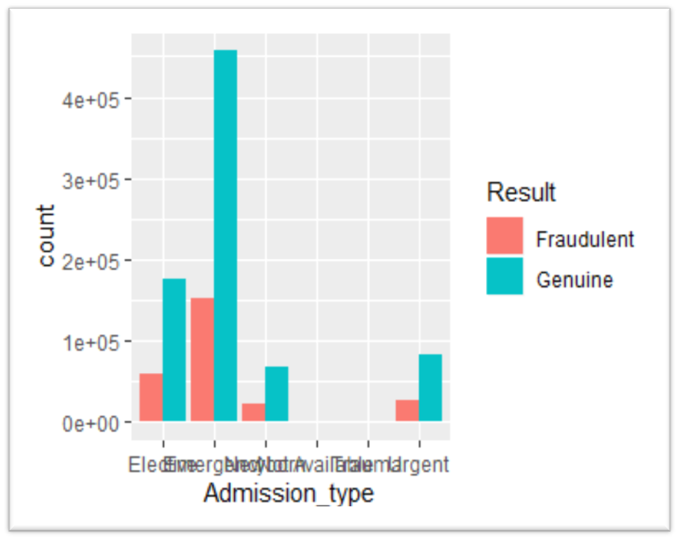
Admission type
From the below chart, The most of the cases are of emergency type of about 6,08,595 cases which is Genuine
As well as proportion of Fraudulent and Genuine are balance

Slide 10
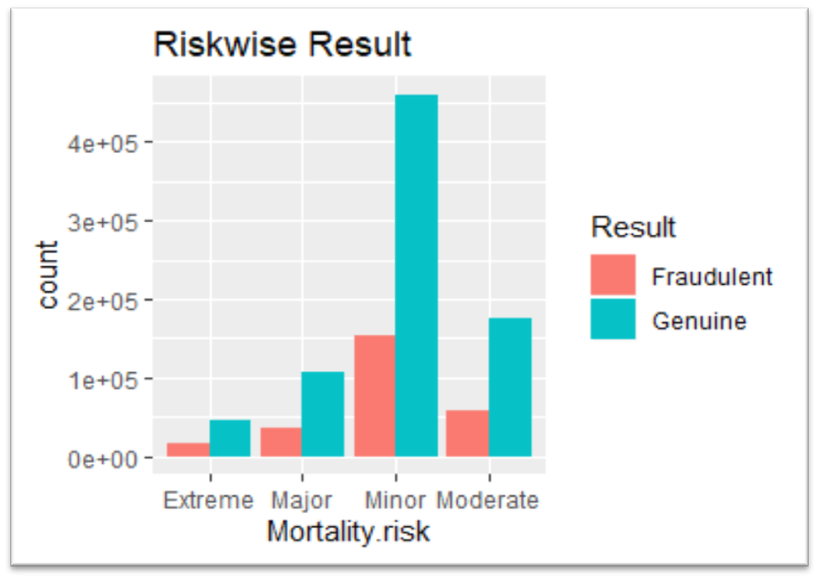
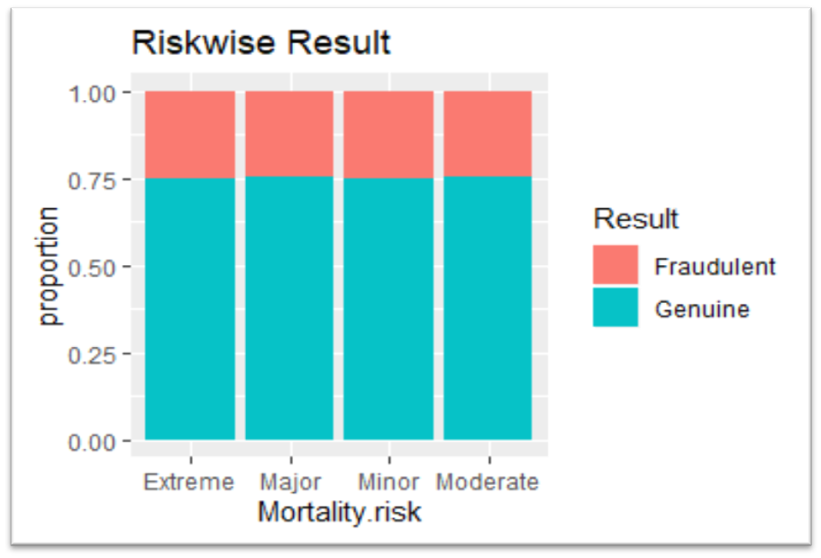
Mortality Risk
In Mortality Risk , there are 615078 cases are of Minor mortality risk of total number of cases
Whereas, 232439 cases of Moderate mortality risk
Bellow that Major and Extreme Mortality Risk are Present

Slide 11
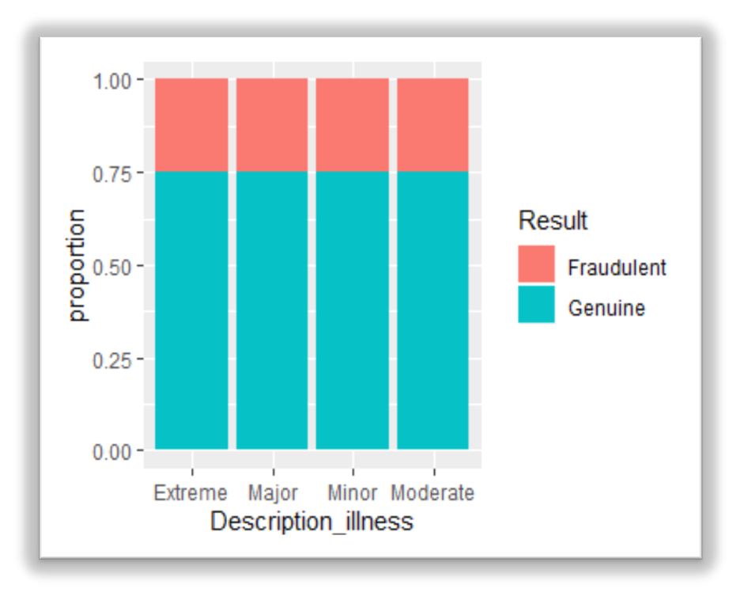
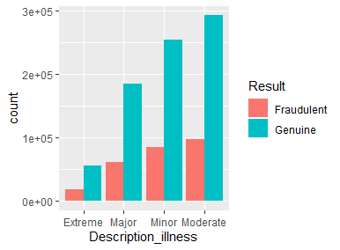
Description Illness
In description illness, there are more no. cases of genuine result is in moderate type
Below that minor (338913) and major (245821) is present

Slide 12
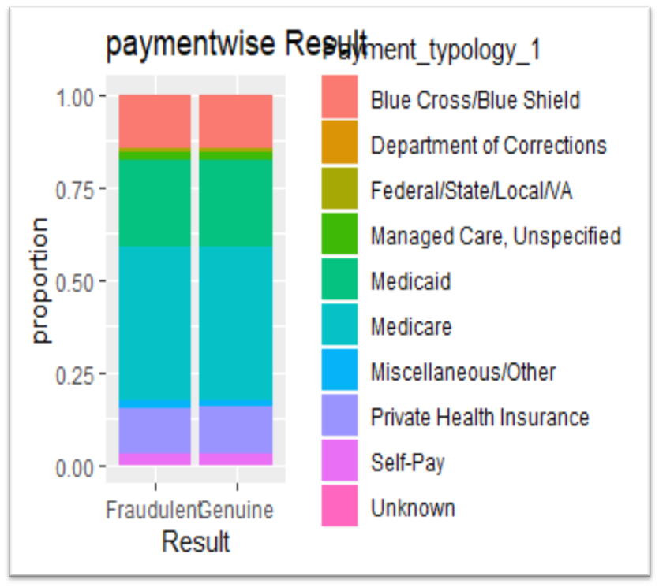
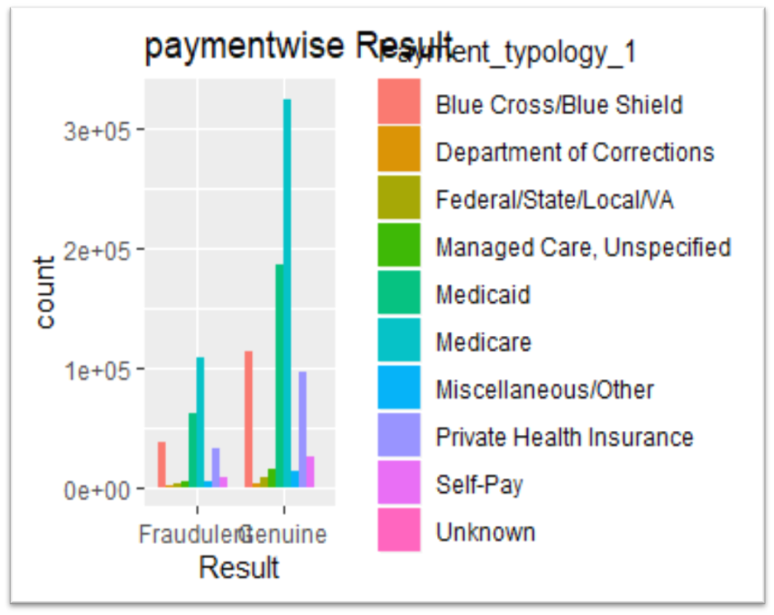
Payment Typology
Almost half of the patients i.e. 4,33,889 were using Medicare insurance whereas 19779 patients do unspecified payment.

Slide 13

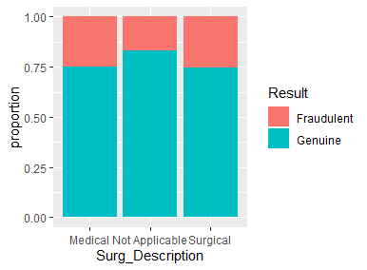
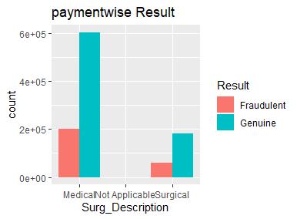
The proportion of surg_Description are same in fraudulent as well as genuine.

Slide 14
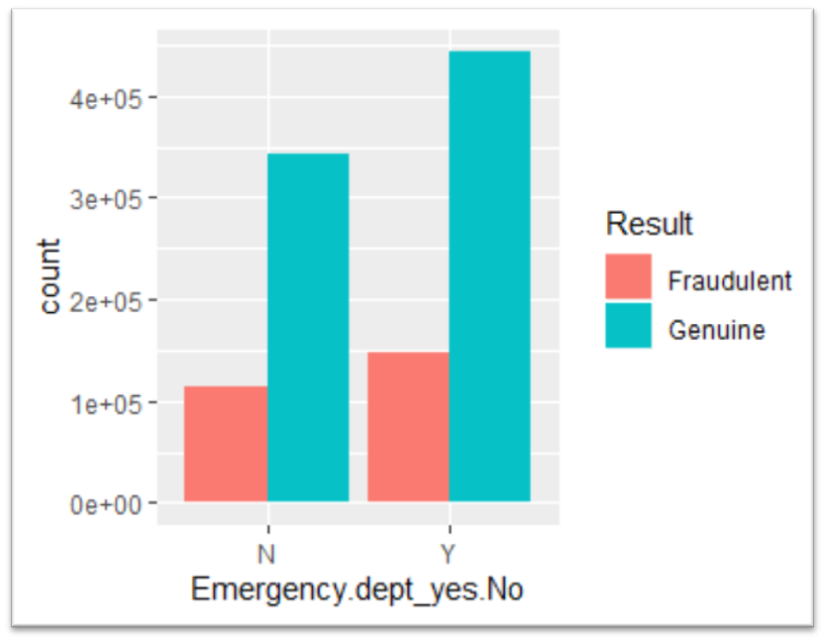
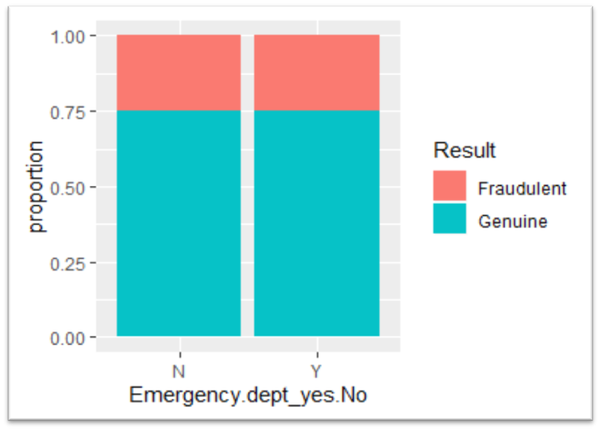
Emergency Department
Proportions of Emergency.dept_yes.No are same in fraudulent as well as in Genuine
There are 585594 patients are from Emergency department having genuine result

Slide 15

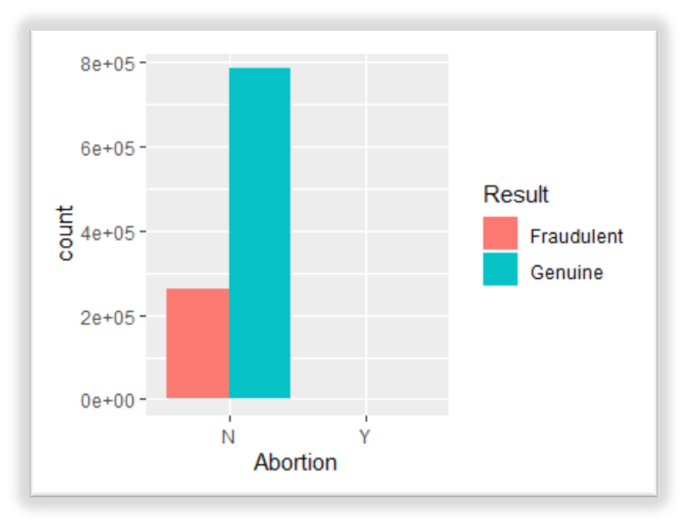
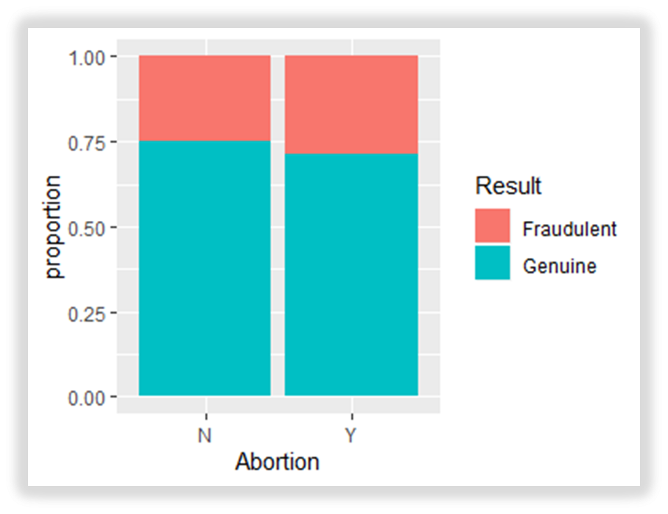
From the abortion chart we conclude that there are 1645 patients are doing abortion whereas 1047110 patients are don’t
As well as proportion of abortion w.r.t result is same in both type

Slide 16
Feature Selection & Preprocessing
Extracted first 15 important categorical features using chi-square test & removed duplicate variables whose have same importance
All Missing values are omitted & Normalize the continuous data (some columns)
Variable Names
Hospital Name
Zip code 3 digits
Days spend hospital
Admission type
Home or self care.
Ccs diagnosis description
Ccs procedure description
Apr drug description
Surg Description
Result
Weight baby
ratio of total costs to total charges

Slide 17
Final Model Building

Slide 18
Decision Tree (Down Sampling) (1,12)
Confusion Matrix and Statistics
 | Reference
Prediction | Fraudulent | Genuine
Fraudulent | 10688 | 32461
Genuine | 66704 | 200078
Conclusion : -
In the confusion matrix, 10688 out of 773392 observations and 200078 out of 232539 observations are correctly classified.
Accuracy | 0.68
95% CI | (0.6784, 0.6817)
No Information Rate | 0.7503
P-Value [Acc > NIR] | 1
Kappa | -0.0017
Mcnemar's Test P-Value | <2e-16
Sensitivity | 0.1381
Specificity | 0.86041
Pos Pred Value | 0.2477
Neg Pred Value | 0.74997
Prevalence | 0.24971
Detection Rate | 0.03449
Detection Prevalence | 0.13922
Balanced Accuracy | 0.49925
'Positive' Class | Fraudulent
Conclusion : -
From the above table,
i) We see that the accuracy of this model is 68% and it may varies between (67.84%, 68.17%).
ii) Here Sensitivity is 0.14 that indicates less proportion of Fraudulent that were correctly classified to the total no. Fraudulent cases.
iii) Here specificity 0.86 that indicates very strong proportion of genuine that were correctly classified to the total no. of genuine cases.

Slide 19
Model Deployment using R shiny
Hospital Name | Zip code | Admission type | Home or self care | Ccs diagnosis description | Ccs procedure description | Apr drug description | Surg Description | Weightbaby | ratio | Days spend | Result | predictions
Albany Medical Center Hospital | 125 | Urgent | Home or Self Care | Influenza | NO PROC | Infections of upper respiratory tract | Medical | 0 | 0.92 | 1 | Genuine | Genuine
St Josephs Hospital Health Center | 132 | Newborn | Home or Self Care | Liveborn | NO PROC | Neonate birthwt >2499g, normal newborn or neonate w other problem | Medical | 1 | 0.73 | 2 | Genuine | Genuine
Kenmore Mercy Hospital | 142 | Emergency | Home w/ Home Health Services | Chronic obstructive pulmonary disease and bronchiectasis | HEMODIALYSIS | Chronic obstructive pulmonary disease | Medical | 0 | 0.74 | 2 | Genuine | Genuine
UPSTATE University Hospital at Community General | 132 | Emergency | Skilled Nursing Home | Fracture of neck of femur (hip) | TRTMNT,FRAC HIP/FEMUR | Hip and femur fracture repair | Surgical | 0 | 1 | 6 | Fraudulent | Fraudulent
White Plains Hospital Center | 105 | Emergency | Inpatient Rehabilitation Facility | Respiratory failure; insufficiency; arrest (adult) | RESP INTUB/MECH VENTIL | Respiratory Failure | Medical | 0 | 0.61 | 11 | Fraudulent | Genuine
Ellis Hospital | 123 | Elective | Home or Self Care | Other acquired deformities | NO PROC | Other back & neck disorders, fractures & injuries | Medical | 0 | 0.54 | 2 | Genuine | Genuine
Buffalo General Medical Center | OOS | Emergency | Home or Self Care | Schizophrenia and other psychotic disorders | NO PROC | Schizophrenia | Medical | 0 | 0.44 | 14 | Genuine | Genuine
The Unity Hospital of Rochester | 144 | Elective | Home w/ Home Health Services | Osteoarthritis | ARTHROPLASTY-NOT HIP/KN | Shoulder, upper arm & forearm procedures except joint replacement | Surgical | 0 | 0.39 | 1 | Fraudulent | Fraudulent
Oneida Healthcare Center | 133 | Urgent | Home or Self Care | Acute cerebrovascular disease | PHYS THER EXER, MANIPUL | CVA & precerebral occlusion w infarct | Medical | 0 | 0.11 | 3 | Genuine | Genuine
Mary Imogene Bassett Hospital | 120 | Urgent | Expired | Other liver diseases | RESP INTUB/MECH VENTIL | Hepatic coma & other major acute liver disorders | Medical | 0 | 0 | 31 | Genuine | Genuine

Slide 20
Challenges faced & How we overcome?
Huge amount of highly imbalanced data
Takes more time for model building
Resulting biased output
Extract important variables by using feature engineering
Used 5 different sampling methods

Slide 21
THANK YOU!

